Slide 1
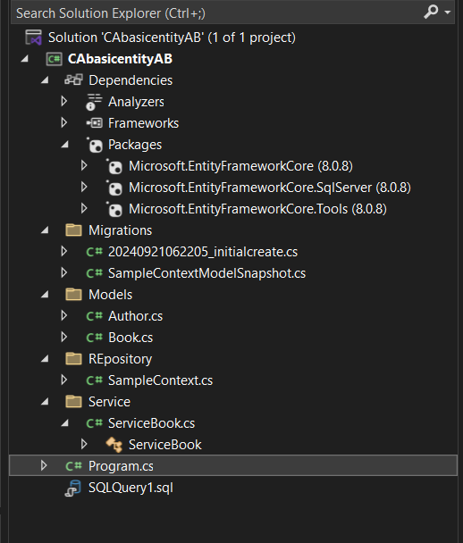

Slide 2

Download Dependency
Install-package Microsoft.EntityFrameworkCore
Install-package Microsoft.EntityFrameworkCore.SqlServer
For VS COde
dotnet add package Microsoft.EntityFrameworkCore.SqlServer
dotnet tool install --global dotnet-ef
Install-package Microsoft.EntityFrameworkCore.Tools
Summary:
// Provides a simple API surface for configuring Microsoft.EntityFrameworkCore.DbContextOptions.
// Databases (and other extensions) typically define extension methods on this object
// that allow you to configure the database connection (and other options) to be
// used for a context.
//
// Remarks:
// You can use Microsoft.EntityFrameworkCore.DbContextOptionsBuilder to configure
// a context by overriding Microsoft.EntityFrameworkCore.DbContext.OnConfiguring(Microsoft.EntityFrameworkCore.DbContextOptionsBuilder)
// or creating a Microsoft.EntityFrameworkCore.DbContextOptions externally and passing it to the context constructor.
// See Using DbContextOptions for more information and examples.
public class DbContextOptionsBuilder : IDbContextOptionsBuilderInfrastructure

Slide 3
public class Author
{
[Key]
public int AuthorId { get; set; }
public string FirstName { get; set; }
public string LastName { get; set; }
public ICollection<Book> Books { get; set; }
}
Primary key
One Author can write many books
AuthorId | FirstName | LastName
Primary Key Auto increment
Foreign Key
namespace CAbasicentityAB.Models
{
public class Book
{
[Key]
public int BookId { get; set; }
public string Title { get; set; }
public Author Author { get; set; }
public int AuthorId { get; set; }
}
}
Indicate one to many relation
BookId | Tile | AuthorId
Using Book reference you can access Author using eager loading
Foreign key

Slide 4
On Delete/Update Cascade
Under this option, when an Author is deleted, the operation will also cascade to dependent tables, resulting in all related books being deleted. When you update the primary key value for an author, all book records containing that value as a foreign key will be updated to the new foreign key value.
AuthorID | Name
1 | Kanitker
2 | James Gosling
3
Book Id | Title | AuthorId
100 | Java | 2
200 | Letus C | 1
when an Author is deleted, the operation will also cascade to dependent tables, resulting in all related books being deleted.

Slide 5
using CAentitycore.Models;
using Microsoft.EntityFrameworkCore;
namespace CAbasicentityAB.REpository
{
public class SampleContext : DbContext
{
protected override void OnConfiguring(DbContextOptionsBuilder optionsBuilder)
{
if(!optionsBuilder. IsConfigured)
optionsBuilder.UseSqlServer(@"Data Source=(localdb)\ProjectModels;Initial Catalog=EntityAuthBook;Integrated Security=True");
}
public DbSet<Book> Books { get; set; }
public DbSet<Author> Authors { get; set; }
}
}
A DbSet represents the collection of all entities in the context, or that can be queried from the database, of a given type. DbSet objects are created from a DbContext using the DbContext.Set method.
Table will be create with name Books
And
Authors
DbContext class
A DbContext instance represents a combination of the Unit Of Work and Repository patterns such that it can be used to query from a database and group together changes that will then be written back to the store as a unit. DbContext is conceptually similar to ObjectContext.
Map to poco class
After this
Add-Migration initialcreate
Update-Database -verbose
Generate 2 file Snapshot and initialcreate migration file with (date time) 2 method Up and down with Sql query.
Execute query

Slide 6
The line protected override void OnConfiguring(DbContextOptionsBuilder optionsBuilder) is a method in Microsoft Entity Framework Core that allows you to configure a context:
What it does
You can use this method to configure the database provider, perform other DbContext configuration, and more.
When it's called
This method is called regardless of how the DbContext is constructed, making it a good place to apply context configuration.
How to use it
You can use the optionsBuilder parameter to create or modify options for the context. For example, you can use the UseSQLServer method in the optionsBuilder to configure SQL Server as the database provider.
How to determine if options are already set
You can use IsConfigured to determine if the options have already been set, which allows you to skip some or all of the logic in OnConfiguring

Slide 7
using CAbasicentityAB.Models;
using CAbasicentityAB.REpository;
using Microsoft.EntityFrameworkCore;
namespace CAbasicentityAB.Service
{
public class ServiceBook
{
private readonly SampleContext db;
internal ServiceBook()
{
db = new SampleContext();
}
public void Addmany()
{
var author = new Author
{
FirstName = "William",
LastName = "Shakespeare",
Books = new List<Book> { new Book { Title = "Hamlet"},
new Book { Title = "Othello" },
new Book { Title = "MacBeth" }
}
};
db.Add(author);
db.SaveChanges();
}
public void AddBook(Book obj)
{
db.Add(obj);
db.SaveChanges();
}
public void RemoveBook(int Id)
{
Book book = db.Books.FirstOrDefault(x => x.BookId == Id);
if (book != null)
{ db.Remove(book); // Book Deleted
db.SaveChanges();
}
}
FromSql
Represents a composite format string at compile time.
Captures the format string and its arguments before formatting.
Allows you to adjust formatting, often using the invariant culture.
Useful for custom formatting scenarios.
Service Class communicate with Dbcontext repository class
Creating object of Samplecontext class through it we will communicate with data base
SaveChanges will fire the query
Add()➔ write insert query
Remove➔ write delete query
Update➔ write update query and update each property

Slide 8
Format it and send it as parameterised query
FromSql(sql) this method parameter has to be FormattableString
public void UpdateBook(Book obj)
{
SampleContext db1 = new SampleContext();
db1.Update(obj);
db1.SaveChanges();
}
public IEnumerable<Book> Display()
{
return db.Books.Include((a) => a.Author).ToList<Book>();
}
public void Display(string title)
{
FormattableString sql = $"SELECT * FROM Books WHERE Title = {title}";
var book = db.Books.FromSql(sql).FirstOrDefault();
Console.Write(book.Title);
var books = db.Books.FromSql($"EXECUTE dbo.GetMostPopularBooks {title}").ToList();
foreach(b in books)
Console.Write(b.Title);
}
public void DeleteAuth(int id ) {
var auth = new Author { AuthorId = id };
db.Remove(auth); // Book Deleted
db.SaveChanges();
}
}
}
CREATE PROCEDURE dbo.GetMostPopularBooks
@BookTitle NVARCHAR(255)
AS
BEGIN
SELECT *
FROM Books
WHERE Title = @BookTitle;
END
Delete auther , will delete author and its books also
db.Books.where(a=>a.Title==title).select(data=>data)

Slide 9
using CAbasicentityAB.Models;
using CAbasicentityAB.Service;
namespace CAbasicentityAB
{
internal class Program
{
static void Main(string[] args)
{
Console.WriteLine("Hello, World!");
ServiceBook servicebook = new ServiceBook();
var book = new Book
{
Title = "let us C",
Author = new Author
{
FirstName = "Yashavant",
LastName = "Kanetkar"
}
};
//Add Author add book
// servicebook.AddBook(book);
//Add multiple record
// servicebook.Addmany();
var bookup = new Book
{
Title = "Test yout skill",
BookId = 4,
AuthorId = 2
};
//servicebook.UpdateBook(bookup);
//servicebook.RemoveBook(5);
servicebook.DeleteAuth(3);
var d = servicebook.Display();
foreach (var item in d)
{
Console.WriteLine($"{item?.Title} {item?.Author?.FirstName} {item?.Author?.LastName} {item?.BookId}");
}
}
}
}
Creating Object of Service class
Calling method of service class which in turn call Add() method of DbContext class.
Then AuthorId is required because it's a non-nullable foreign key, so EF Core expects you to always supply it when updating or inserting.
Then EF Core marks the entire object as modified, meaning it tries to update all columns — not just Title. So if AuthorId is not supplied, and it's non-nullable in the database, it throws an error or sets it to 0 (which violates constraints).
If Id 3 not found it will throw Exception
See next slide
Notes:
--

Slide 10

Can we log query fired by entity? yes
public class SampleContext : DbContext
{
protected override void OnConfiguring(DbContextOptionsBuilder optionsBuilder)
{
if (!optionsBuilder.IsConfigured)
optionsBuilder.UseSqlServer(@"Data Source=(localdb)\ProjectModels;Initial Catalog=ADOcode;Integrated Security=True")
.LogTo(Console.WriteLine, LogLevel.Information)
.EnableSensitiveDataLogging(); ;
}

Slide 11
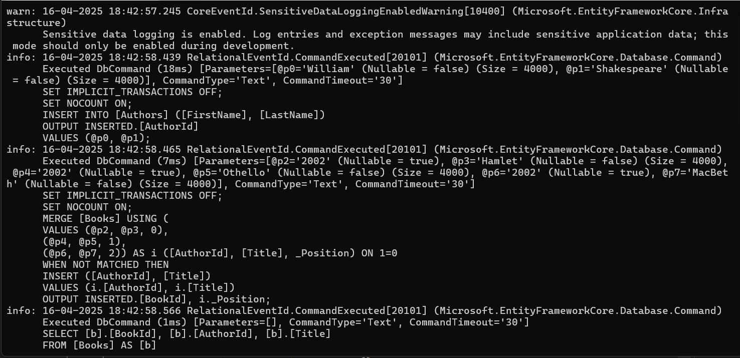

Slide 12
System.InvalidOperationException: 'The instance of entity type 'Book' cannot be tracked because another instance with the key value '{BookId: 4}' is already being tracked. When attaching existing entities, ensure that only one entity instance with a given key value is attached.'
public void UpdateBook(Book obj)
{
var existingBook = db.Books.Find(obj.BookId);
if (existingBook != null)
{
// Detach the existing entity to avoid conflicts
db.Entry(existingBook).State = EntityState.Detached;
}
// Now, update the book
db.Update(obj);
db.SaveChanges();
}
The error you're encountering indicates that you're trying to attach an entity (Book) with the same primary key (BookId: 4) multiple times to the Entity Framework (EF) context. Entity Framework (EF) tracks entities by their primary key, and it doesn't allow two different instances of an entity with the same key value to be tracked simultaneously. This can happen in various scenarios, such as when you're trying to attach or update an entity that's already being tracked by the context.
OR
public void UpdateBook(Book obj)
{
db.Entry(existingBook).State = EntityState.Modified;
db.SaveChanges();
}

Slide 13
OR

Slide 14
What if we want foreign key to be nullable and On Delete/Update Set Null

Slide 15
public class Author
{
[Key]
public int AuthorId { get; set; }
public string FirstName { get; set; }
public string LastName { get; set; }
public ICollection<Book> Books { get; set; }
}
Primary key
One Author can write many books
AuthorId | FirstName | LastName
Primary Key Auto increment
Foreign Key
namespace CAbasicentityAB.Models
{
public class Book
{
[Key]
public int BookId { get; set; }
public string Title { get; set; }
public Author Author { get; set; }
public int? AuthorId { get; set; }
}
}
Indicate one to many relation
BookId | Tile | AuthorId
Using Book reference you can access Author using eager loading
Foreign key

Slide 16
using CAentitycore.Models;
using Microsoft.EntityFrameworkCore;
namespace CAbasicentityAB.REpository
{
public class SampleContext : DbContext
{
protected override void OnConfiguring(DbContextOptionsBuilder optionsBuilder)
{
if(!optionsBuilder. IsConfigured)
optionsBuilder.UseSqlServer(@"Data Source=(localdb)\ProjectModels;Initial Catalog=EntityAuthBook;Integrated Security=True");
}
public DbSet<Book> Books { get; set; }
public DbSet<Author> Authors { get; set; }
}
}
A DbSet represents the collection of all entities in the context, or that can be queried from the database, of a given type. DbSet objects are created from a DbContext using the DbContext.Set method.
Table will be create with name Books
And
Authors
DbContext class
A DbContext instance represents a combination of the Unit Of Work and Repository patterns such that it can be used to query from a database and group together changes that will then be written back to the store as a unit. DbContext is conceptually similar to ObjectContext.
Map to poco class
After this
Add-Migration initialcreate
Update-Database -verbose
Generate 2 file Snapshot and initialcreate migration file with (date time) 2 method Up and down with Sql query.
Execute query

Slide 17
On Delete/Update No Action
This is the default option if ON DELETE or ON UPDATE is not specified. If an attempt is made to delete an Author record that is currently referenced by a Book record, the database will raise an error and the delete will be rolled back. The same will happen if an attempt is made to alter the primary key value of an Author record that is being used as a foreign key in a Book record.
On Delete/Update Restrict
For the majority of relational database systems, RESTRICT is equivalent to NO ACTION. Where RESTRICT is specifically implemented by a database system, the difference is that RESTRICT results in the constraint being checked at the start of processing instead of at the end, which is the case with NO ACTION
AuthorID | Name
1 | Kanitker
2 | James Gosling
3
Book Id | Title | AuthorId
100 | Java | 2
200 | Letus C | 1
to delete an Author record that is currently referenced by a Book record, the database will raise an error

Slide 18
On Delete/Update Set Null
If an Author record that is currently referenced in one or more Book records is deleted, the AuthorId value in the affected Book records will be updated to NULL. The same will happen if the Author record's primary key value is changed. This operation will only be successful if the AuthorId column in the Books table is nullable.
On Delete/Update Set Default
When an Author record is deleted or has its key value amended, foreign key values in the Books table linked to the affected Author record will be changed to their default value. The foreign key fields in the affected tables must either have a default value specified, or be nullable, in which case NULL is considered the default value. Any non-NULL default value must relate to an existing key in the principal table.
How to achieve this setting??
AuthorID | Name
1 | Kanitker
2 | James Gosling
3
Book Id | Title | AuthorId
100 | Java | 2
200 | Letus C | 1
NULL
This operation will only be successful if the AuthorId column in the Books table is nullable.
If an Author record that is currently referenced in one or more Book records is deleted, the AuthorId value in the affected Book records will be updated to NULL

Slide 19
Override parent vitual method in context class
protected override void OnModelCreating(ModelBuilder modelBuilder)
{
modelBuilder.Entity<Book>()
.HasOne(b => b.Author)
.WithMany(a => a.Books)
.HasForeignKey(b => b.AuthorId)
.OnDelete(DeleteBehavior.SetNull);
}
Above code execute only one time when it try's to create Tables

